Slide 1

15EC502 – Linear Integrated Circuits

Slide 2
UNIT II APPLICATIONS OF OPERATIONAL AMPLIFIERS
Sign Changer
Scale Changer
Voltage Follower
Adder & Subtractor
Instrumentation amplifier
Integrator & Differentiator
Low–pass, High–pass and Band–pass filters
Phase Shift Circuits
Comparators & Schmitt trigger
Multivibrators
Sine–wave generators
Precision rectifier
V to I and I to V converters.

Slide 3
OP AMP APPLICATIONS
Two types of Applications,
Linear Applications
Non-Linear Applications

Slide 4
Linear Applications
Addition
Subtraction
Multiplication
Current to Voltage and Voltage to current conversion
Integration
Differentiation
Active Filters
Comparators
Schmitt trigger
Instrumentation Amplifier
F to V converter

Slide 5
2. Non-Linear Applications
Comparators
Logarithmic amplifiers
Exponential amplifiers
Peak detectors
Precision rectifiers
Waveform generators
Clippers & clampers

Slide 6
Inverter and Scale Changer
Linear Applications
Inverting Amp with Gain = - Rf / Ri
Inverter
Rf / Ri = 1
Inverter and Scale Changer
Proper choice of Rf / Ri
Application
Use of inverter to scale the output of DAC

Slide 7
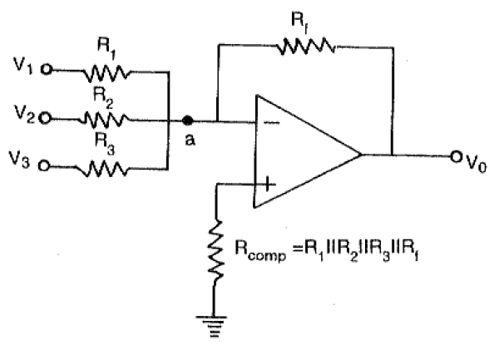
Summing Amplifier (Inverting)
Linear Applications

Slide 8
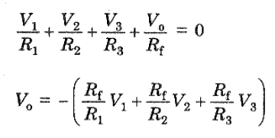
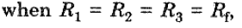
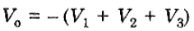
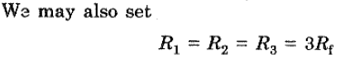
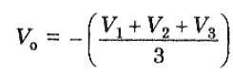
Summing Amplifier (Inverting)
Linear Applications

Slide 9
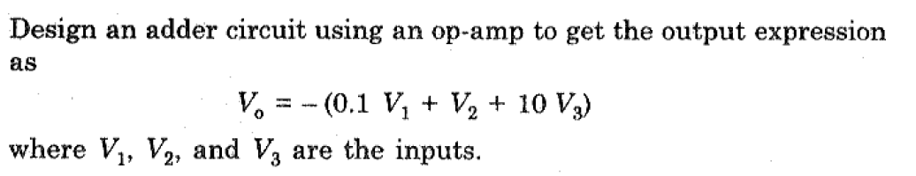
Summing Amplifier (Inverting)
Linear Applications
Problem

Slide 10
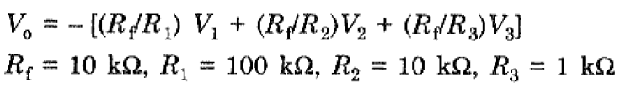
Summing Amplifier (Inverting)
Linear Applications
Solution

Slide 11
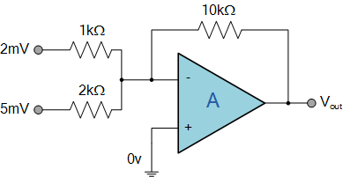
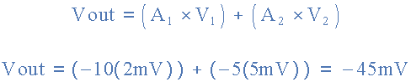
Summing Amplifier (Inverting)
Linear Applications
Home Work

Slide 12
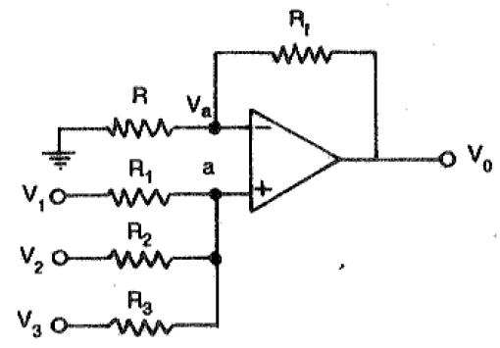
Summing Amplifier (Non - Inverting)
Linear Applications

Slide 13
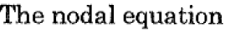
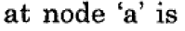
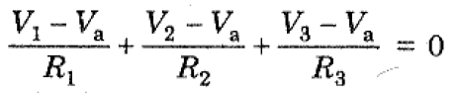
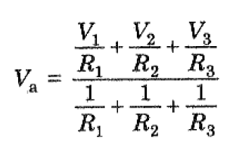
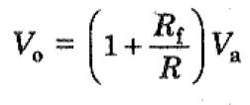
Summing Amplifier (Non - Inverting)
Linear Applications

Slide 14
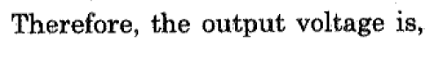
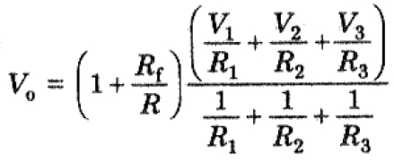
Summing Amplifier (Non - Inverting)
Linear Applications
Ref.: https://www.youtube.com/watch?v=2cqgg0PPRNg

Slide 15
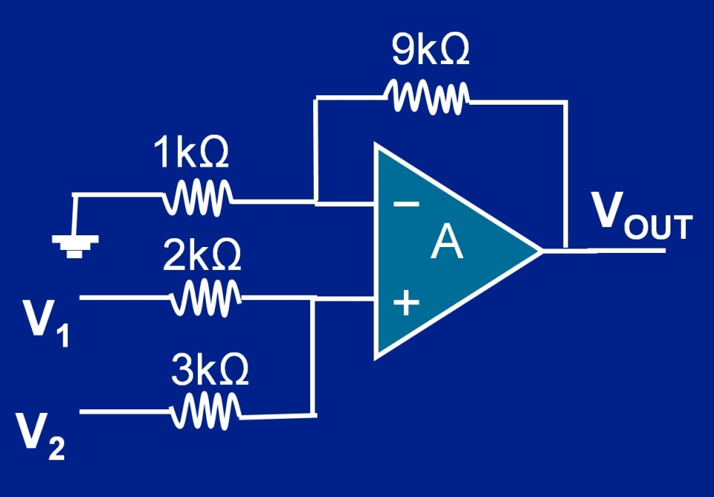
Summing Amplifier (Non - Inverting)
Linear Applications
Home Work
For V₁ = 3V and V₂ = -4V We get
V_{OUT} = (6 X 3V) - (4 X 4V) = 2V

Slide 16
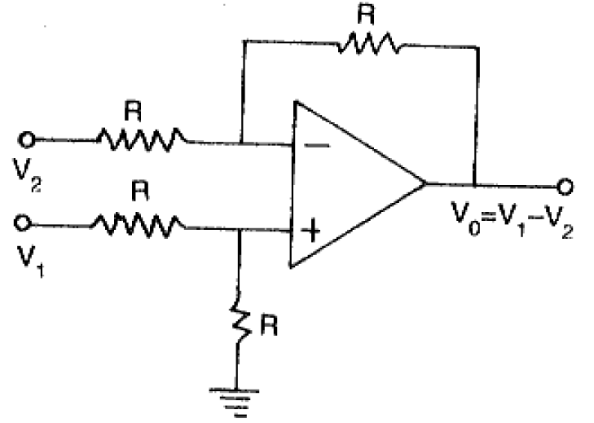
Subtractor
Linear Applications

Slide 17
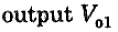
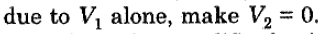
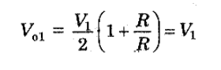
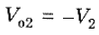
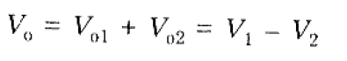
Subtractor
Linear Applications
Use Super Position Principle,

Slide 18
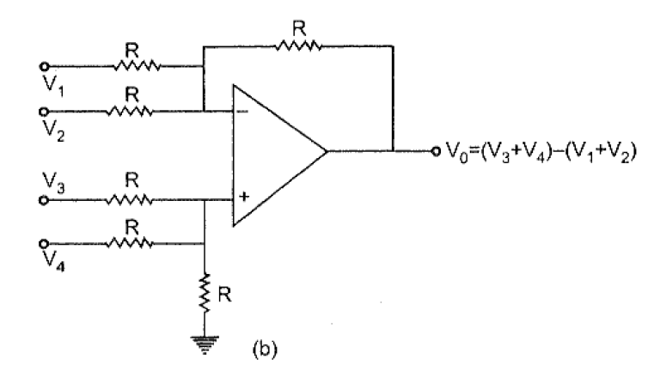
Adder - Subtractor
Linear Applications

Slide 19
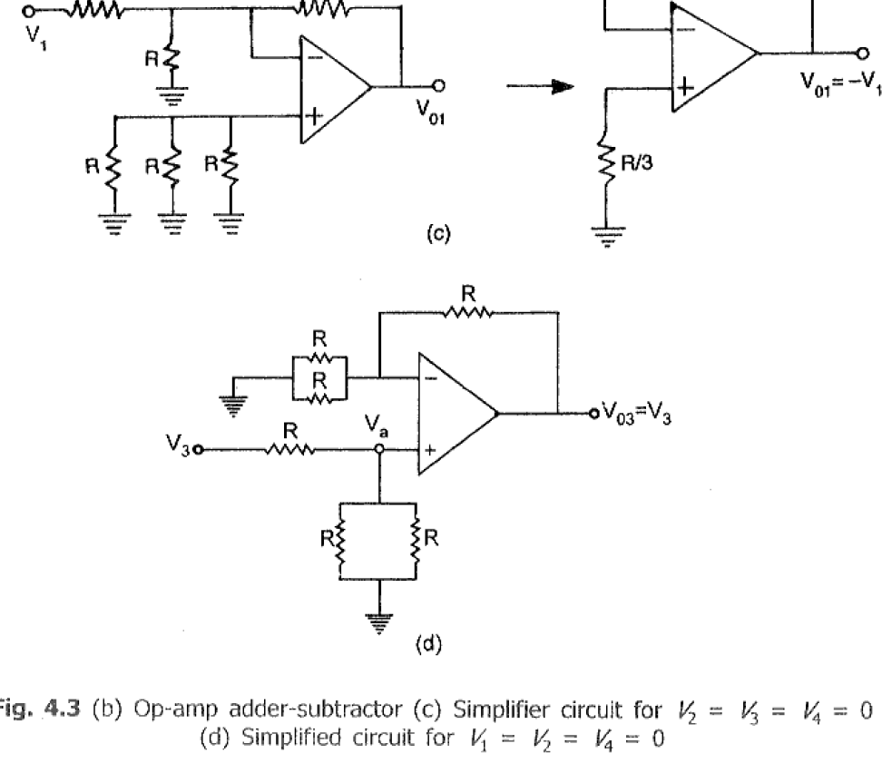
Adder - Subtractor
Linear Applications

Slide 20
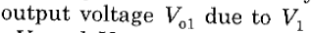
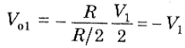
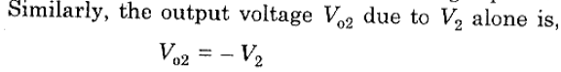
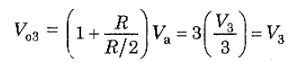
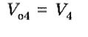
Adder - Subtractor
Linear Applications
METHOD: 1
Use Superposition Principle, then

Slide 21
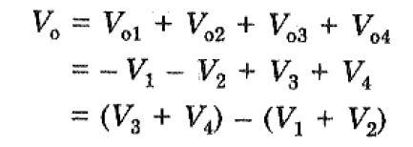
Adder - Subtractor
Linear Applications
METHOD: 1

Slide 22
Adder - Subtractor
Linear Applications
METHOD: 2
Use Nodal Analysis, then
Write Nodal equation at Node ‘a’ (Inverting Terminal)
Write Nodal equation at Node ‘b’ (Non-Inverting Terminal)
Consider, V_{a} = V_{b} ➔ V_{a} in the above two equations.
Then, V_{a} from the Step 3.
Find V₀ from Step 4.
End.

Slide 23
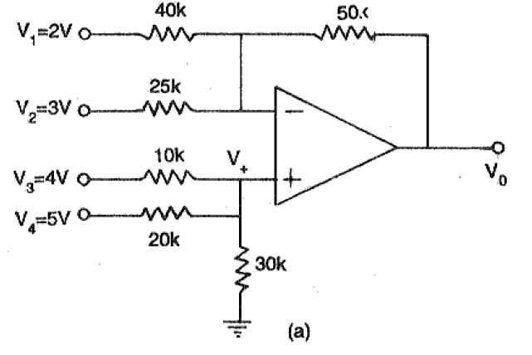
Adder - Subtractor
Linear Applications
Home Work
V₀ = 6.58V

Slide 24
Instrumentation Amplifier
Linear Applications
Instrumentation amplifier is a kind of differential amplifier with additional input buffer stages.
The addition of input buffer stages makes it easy to match (impedance matching) the amplifier with the preceding stage.
Instrumentation are commonly used in industrial test and measurement application.
The instrumentation amplifier also has some useful features,
Low offset voltage
High CMRR (Common mode rejection ratio)
High input resistance
High gain
High accuracy
High gain stability
Low output Resistance etc.

Slide 25
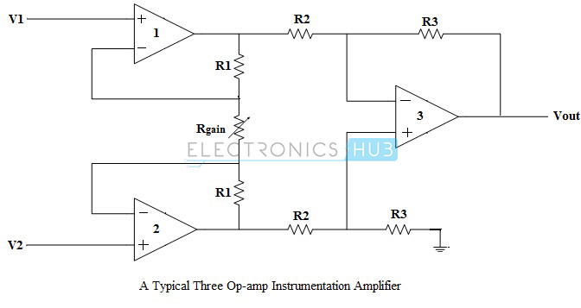
Instrumentation Amplifier
Linear Applications

Slide 26
Instrumentation Amplifier
Working of Instrumentation Amplifier
The output stage of the instrumentation amplifier is a difference amplifier,
Hence, output V_{out} is the amplified difference of the input signals applied to its input terminals.
The outputs of op-amp 1 and op-amp 2 are V_{o1} and V_{o2} respectively
V_{out} = (R₃/R₂)(V_{o1}-V_{o2})

Slide 27
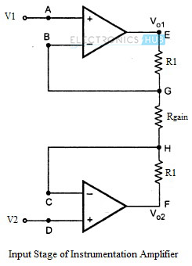
Instrumentation Amplifier
Working of Instrumentation Amplifier
Consider the input stage of the instrumentation amplifier,

Slide 28
Instrumentation Amplifier
Working of Instrumentation Amplifier
The potential at node A is the input voltage V₁. Hence the potential at node B is also V₁, from the virtual ground concept. Thus, the potential at node G is also V₁.
The potential at node D is the input voltage V₂. Hence the potential at node C is also V₂, from the virtual ground. Thus, the potential at node H is also V₂.
Ideally the current to the input stage op-amps is zero. Therefore the current I through the resistors R₁, R_{gain} and R₁ remains the same.
Applying Ohm’s law between the nodes E and F,
I = (V_{o1}-V_{o2})/(R₁+R_{gain}+R₁)
I = (V_{o1}-V_{o2})/(2R₁+R_{gain}) ——————— 1
Since no current is flowing to the input of the op-amps 1 & 2, the current I between the nodes G and H can be given as,
I = (V_{G}-V_{H})/R_{gain} = (V₁-V₂)/R_{gain} ————————- 2

Slide 29
Instrumentation Amplifier
Working of Instrumentation Amplifier
Equating equations 1 and 2,
(V_{o1}-V_{o2})/(2R₁+R_{gain}) = (V1-V₂)/R_{gain}
(V_{o1}-V_{o2}) = (2R₁+R_{gain})(V₁-V₂)/R_{gain} —————— 3
The output of the difference amplifier is given as,
V_{out} = (R₃/R₂) (V_{o1}-V_{o2})
Therefore, (V_{o1} – V_{o2}) = (R₂/R₃)V_{out} —————— 4
Substituting (V_{o1} – V_{o2}) value in the equation 3, we get
(R₂/R₃)V_{out} = (2R₁+R_{gain})(V1-V₂)/R_{gain}
i.e. V_{out} = (R₃/R2){(2R₁+R_{gain})/R_{gain}}(V1-V₂)
The above equation gives the output voltage of an instrumentation amplifier.
The overall gain of the amplifier is given by the term (R₃/R2){(2R₁+R_{gain})/R_{gain}}.

Slide 30
Instrumentation Amplifier
Note:
The overall voltage gain of an instrumentation amplifier can be controlled by adjusting the value of resistor R_{gain}.
The common mode signal attenuation for the instrumentation amplifier is provided by the difference amplifier.
Advantages of Three Op-amp Instrumentation Amplifier
The gain of a three op-amp instrumentation amplifier circuit can be easily varied and controlled by adjusting the value of R_{gain} without changing the circuit structure.
The gain of the amplifier depends only on the external resistors used. Hence, it is easy to set the gain accurately by choosing the resistor values carefully.
The input impedance of the instrumentation amplifier is dependent on the non-inverting amplifier circuits in the input stage. The input impedance of a non-inverting amplifier is very high.
The output impedance of the instrumentation amplifier is the output impedance of the difference amplifier, which is very low.
The CMRR of the op-amp 3 is very high and almost all of the common mode signal will be rejected.

Slide 31
Instrumentation Amplifier
Difference between Operational Amplifier and Instrumentation Amplifier
The key differences between the operational amplifier and instrumentation amplifier include the following.
An operational amplifier (op-amp) is one kind of an integrated circuit
The instrumentation amplifier is one type of differential amplifier
Instrumentation amplifier can be built with three operational amplifiers.
The differential amplifier can be built with a single operational amplifier.
The output voltage of difference amplifier gets affected because of the mismatch resistors
Instrumentation amplifier offers gain with a single resistor of its primary phase which does not need a resistor matching.

Slide 32
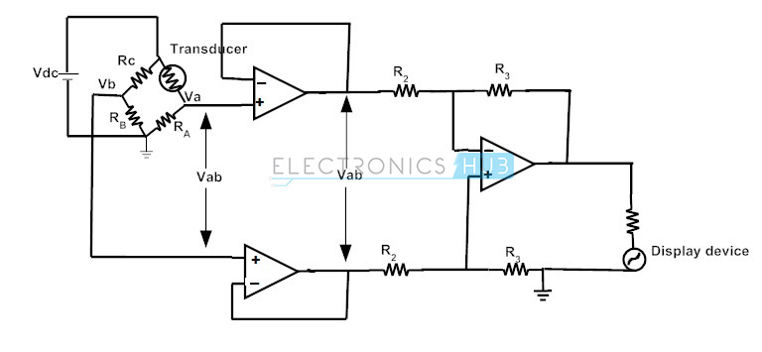
Instrumentation Amplifier
Application of Instrumentation Amplifier
Transducer Bridge Instrumentation Amplifier
Ref.: https://www.electronicshub.org/instrumentation-amplifier-basics-applications/

Slide 33
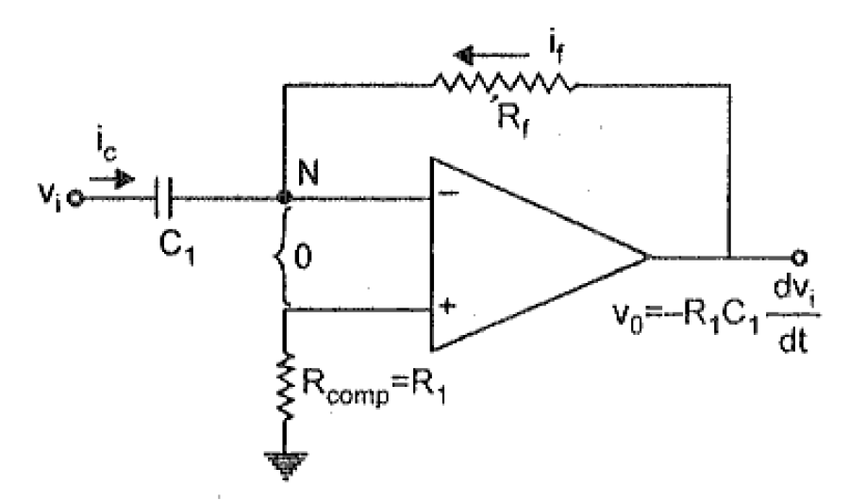
Differentiator (Differentiator Amplifier)
Produces a voltage output which is directly proportional to the input voltage’s rate-of-change with respect to time

Slide 34
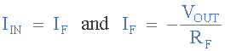
Differentiator (Differentiator Amplifier)
Assume it is Ideal Op-Amp, hence,
Current into the terminals are Zero
Input differential Voltage Vd = 0.
Since the node voltage of the operational amplifier at its inverting input terminal is zero, the current, i flowing through the capacitor will be given as
The charge on the capacitor equals Capacitance times Voltage across the capacitor

Slide 35
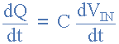
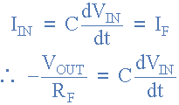
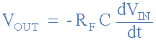
Differentiator (Differentiator Amplifier)
Thus the rate of change of this charge is:
but dQ/dt is the capacitor current, i
from which an ideal voltage output for the op-amp differentiator
Vout is a constant –Rƒ*C times the derivative of the input voltage Vin with respect to time. The minus sign (–) indicates a 180º phase shift because the input signal is connected to the inverting input terminal

Slide 36
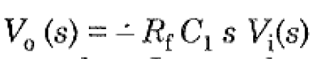
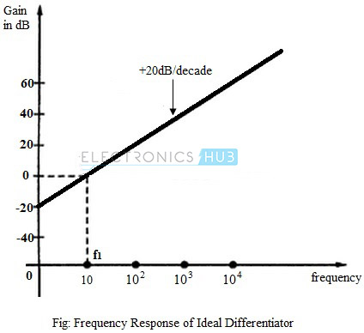
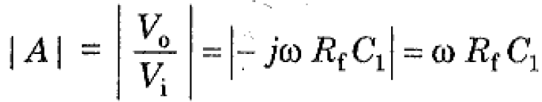
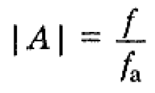
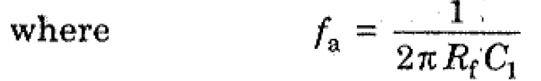
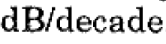
Differentiator (Differentiator Amplifier)
Taking Laplace Transform for the above and substitute s = jɷ,

Slide 37
Differentiator (Differentiator Amplifier)
Drawbacks
Disadvantages of Ideal Differentiator :
The gain of the differentiator increases as frequency increases. Thus at some high frequency, the differentiator may become unstable and break into oscillations.
Also, the input impedance decreases as frequency increases. This makes circuit very much sensitive to the noise .

Slide 38
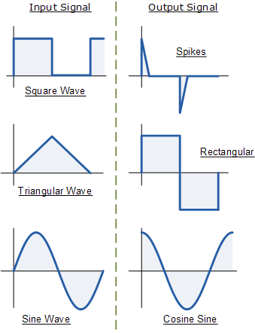
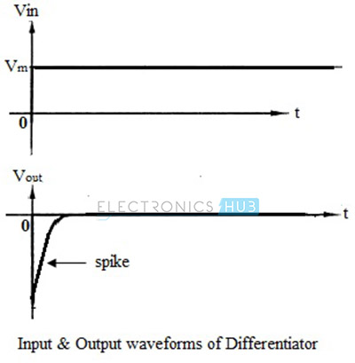
Differentiator (Differentiator Amplifier)
Waveforms

Slide 39
Practical Differentiator
In order to eliminate the
Instability and
High frequency noise
of the basic Differentiator, the Practical Differentiator has existence.

Slide 40

Practical Differentiator

Slide 41

Practical Differentiator
The above circuit is similar to Non-Inverting Amplifier,
V₀/V_{i} = - R_{f}/R_{i} = -Z_{f}/Z₁ ------ (1)
Remember:
Laplace Transform of,
R = R
Cd/dt = 1/sC
From the diagram,
Z_{f} = Parallel Combination of R_{f} and C_{f};
Z₁ = Series Combination of R₁ and C₁.
Z_{f} = R_{f} || C_{f} = (R_{f}/sC_{f}) / (Rf +(1/sC_{f}) ------ (2)
Z_{f} = (R_{f}) / (1+sR_{f}C₁) ------ (3)
Z₁ = R₁ + (1/sC₁) = (1+R₁C₁s)/sC₁ ------ (4)
Sub. (3) and (4) in eqn. (1), we get,
------ (5)

Slide 42



Practical Differentiator
Sub. R₁C₁ = R_{f}C_{f} in eqn. (5), we get,
------ (6)
Sub. s = jω and ω = 2Πf in eqn. (6), we get,
------ (7)

Slide 43

Practical Differentiator
Substituting the values of frequencies f_{a} and f_{b} , the gain A is

Slide 44

Practical Differentiator

Slide 45

Practical Differentiator
From the above frequency response,
f < f_{b}, the gain A is increasing at 20dB/decade.
f > f_{b}, the gain A is decreasing at 20dB/decade.
It is due to R₁C₁ & R_{f}C_{f}
For a good differentiator,
f_{a} < f_{b} < f_{c} (fc is unity gain-bandwidth of op-amp in Open loop.
T > R_{f}C₁
If, R_{f}C₁ > R₁C₁ & R_{f}C_{f} then it becomes basic Differentiator.

Slide 46

Practical Differentiator
Problem

Slide 47

Practical Differentiator
Problem

Slide 48

Practical Differentiator
Problem

Slide 49

Practical Differentiator
Problem

Slide 50

Practical Differentiator
Problem

Slide 51

Integrator

Slide 52


Integrator

Slide 53



Integrator
Taking Laplace Transform for the above and substitute s = jɷ,
or
|A| = f_{b}/f; where, f_{b} = 1/2ΠR₁C_{f}

Slide 54

Integrator

Slide 55
Integrator
From the above frequency response,
f = 0, then A is infinite (C does not conduct DC - open loop)
0 < f < f_{b}, the gain A is decreasing at 20dB/decade.
f > f_{b}, the gain A is decreasing at 20dB/decade below Zero.
Issue to be Solved is,
f = 0, then A is infinite (C does not conduct DC - open loop)

Slide 56

Practical Integrator
In order to avoid the saturation of Integration at low frequencies, an R_{f} is connected in parallel with C_{f}.

Slide 57
Practical Integrator (Lossy)
The R_{f} and C_{f} combination dissipates power, that’s why it is called as Lossy Integrator.
The gain at the Low frequency is limited to (-R_{f}/R₁) and R_{f} = 10 R₁. Thus DC stabilization is achieved.
Analysis
The above circuit is similar to Non-Inverting Amplifier,
V₀/V_{i} = - R_{f}/R_{i} = -Z_{f}/Z₁ ------ (1)
From the diagram,
Z_{f} = Parallel Combination of R_{f} and C_{f};
Z₁ = Series Combination of R₁ alone.
Z_{f} = R_{f} || C_{f} = (R_{f}/sC_{f}) / (Rf +(1/sC_{f}) ------ (2)
Z_{f} = (R_{f}) / (1+sR_{f}C₁) ------ (3)
Z₁ = R₁ ------ (4)

Slide 58

Practical Integrator (Lossy)
Analysis
Sub. (3) and (4) in eqn. (1), we get,
V₀ (s) /V_{i} (s) = - ((R_{f}/R₁) / (1+sR_{f}C_{f}) ------ (5)
Sub. s = jω and ω = 2Πf in eqn. (5), we get,
Sub. f_{a} = 1 / 2ΠR_{f}C_{f} above eqn. becomes,
|A| = - ((R_{f}/R₁) / √(1+(f/f_{a})²) ------ (6)

Slide 59
Practical Integrator (Lossy)
Analysis
|A| = - ((R_{f}/R₁) / √(1+(f/f_{a})²) ------ (6)
Consider the following cases:
1. When f=0 ,the gain |A|=|R_{f}/R₁| —–dc gain 2. When 0<f<f_{a} ,the gain |A|≅|R_{f}/R₁| 3. When f>f_{a} ,the gain |A|≪|R_{f}/R₁| 4. When f= f_{a} , the gain |A|=|R_{f}/R₁ (1/√2) |
Hence, |A|=|0.707 (R_{f}/R₁) |

Slide 60

Practical Integrator (Lossy)
1. When f=0 ,the gain |A|=|R_{f}/R₁| —–dc gain 2. When 0<f<f_{a} ,the gain |A|≅|R_{f}/R₁| 3. When f>f_{a} ,the gain |A|≪|R_{f}/R₁| 4. When f= f_{a} , the gain |A|=|R_{f}/R₁ (1/√2) |
Hence, |A|=|0.707 (R_{f}/R₁) |

Slide 61
Practical Integrator (Lossy)
Thus we can have following observations from frequency response of practical integrator:
Bandwidth of practical integrator is f_{a} which is higher than BW of an ideal integrator.
DC gain (at f=0) is |R_{f}/R₁| which is typically ≥10.
For better integration f_{b} ≥ 10f_{a} (99% Accuracy).
For proper integration Time period T of input signal ≥R_{f} C_{f}

Slide 62

Practical Integrator (Lossy)
Problem

Slide 63


Practical Integrator (Lossy)
Solution

Slide 64

Practical Integrator (Lossy)
Solution

Slide 65

Practical Integrator (Lossy)
Solution

Slide 66


Practical Integrator (Lossy)
Solution

Slide 67



Practical Integrator (Lossy)
Solution

Slide 68
Active Filters

Slide 69
Active Filters
Filters are circuits that are capable of passing signals within a band of frequencies while rejecting or blocking signals of frequencies outside this band. This property of filters is also called “frequency selectivity”.
Filter can be Passive or Active filter.
Passive filters:
The circuits built using RC, RL, or RLC circuits.
Active filters :
The circuits that employ one or more op-amps in the design an addition to resistors and capacitors

Slide 70
Active Filters
There are two broad categories of filters:
An analog filter processes continuous-time signals
A digital filter processes discrete-time signals.
The analog or digital filters can be subdivided into four categories:
Low pass Filters
High pass Filters
Band stop Filters
Band pass Filters

Slide 71

Active Filters

Slide 72
Active Filters
Passive Filters Disadvantages:
Made up of passive components - resistors, capacitors and inductors
No amplifying éléments (transistors, op-amps, etc)
No signal gain
1st order - design is simple (just use standard equations to find resonant frequency of the circuit)
2nd order - complex equations
Require no power supplies
Buffer amplifiers might be required
Desirable to use inductors with high quality factors
Inductor
Physical size, and large inductance values are required.
Often prohibitively expensive.
Difficult to implement at frequencies below 1 kHz.
Lossy

Slide 73
Active Filters
Active Filters Advantages:
No inductors
Made up of op-amps, resistors and capacitors
Provides arbitrary gain
High input impedance prevents excessive loading of the driving source
Low output impedance prevents the filter from being affected by the load
Easy to adjust over a wide frequency range without altering the desired response.
Reduced size and weight
Increased reliability and improved performance

Slide 74

Active Filters
First Order Low Pass Filter

Slide 75


V = IR
I = V/R

Slide 76
Active Filters
In the circuit we have:
Voltage ‘Vin’ as an input voltage signal which is analog in nature.
Voltage ‘Vo’ is the output voltage of the operational amplifier.
Resistors ‘R_{F}’ and ‘R₁’ are the negative feedback resistors of the operational amplifier.
There is a single R-C network (marked in the red square) present in the circuit hence the filter is a first-order low pass filter
‘R_{L}’ is the load resistance connected at the op-amp output.

Slide 77
Active Filters
V₀ = (1 + (R_{f}/R_{i}))V₁ ------ (1)
Apply Nodal eqn. at Node V₁,
(V₁-V_{i})/R + C(dV₁/dt) = 0
(V₁/R) + C(dV₁/dt) = (V_{i}/R) ---- (2)
Taking Laplace Transform in eqn (2),
(V₁(s)/R) + sCV₁(s) = V_{i}(s)/R ---- (3)
Simplifying eqn (3),
V₁(s) = V_{i}(s)/(1+sCR) ---- (4)
V₁(s)/V_{i}(s) = 1/(1+sCR) ---- (5)

Slide 78
Active Filters
From eqn. (1), the Closed Loop Gain (A₀) is,
A₀ = V₀(s)/ V₁(s) = (1 + (R_{f}/R_{i})) ------ (6)
From the diagram, the overall Transfer function is,
H(s) = V₀(s)/ V_{i}(s) = (V₀(s)/ V₁(s)) . (V₁(s)/ V_{i}(s)) ------ (7)
Using eqn. (5) and (6) in (7) gives,
H(s) = (1 + (R_{f}/R_{i})) /(1+sCR) ------ (8)
Or
H(s) = A₀ /(1+sCR) ------ (9)
Where, A₀ is Gain of Non-Inverting Amp.
Ref.: https://circuitdigest.com/tutorial/butterworth-filters-first-order-and-second-order-low-pass-butterworth-filters

Slide 79
Active Filters
H(s) = A₀ /(1+sCR) ------ (9)
Sub. ω_{h} = 1/RC in eqn. (9), then,
H(s) = V₀(s)/ V_{i}(s) = A₀ /(1+s/ ω_{h} )
H(s) = A₀ω_{h}/(ω_{h}+s) ------ (10)
Put s = jω in eqn. (9), then,
H(jω) = A₀ /(1+ jωCR) ------ (11)
Use f_{h} = 1/2ΠRC (Cut-off frequency of the Filter) in eqn. (11) then,
H(jω) = A₀ /(1+ j(f/f_{h})) ------ (12)
|H(jω)| = A₀ /√(1+ (f/f_{h})²) ------ (13)

Slide 80

Active Filters
|H(jω)| = A₀ /√(1+ (f/f_{h})²) ------ (13)
Case i : f << f_{h} (input frequency is very less than the cutoff frequency), ==> |H(jω)| = A₀
Case ii : f = f_{h} (input frequency is equal to the cutoff frequency),
==> |H(jω)| = 0.707 A₀
Case iii: f > f_{h} (input frequency is higher than the cutoff frequency),
==> |H(jω)| < A₀ (20 dB/decade)

Slide 81

Active Filters
Second Order Low Pass Filter

Slide 82
Active Filters
Second Order Low Pass Filter
For a Non-Inverting Amplifier,
V₀ = (1 + (R_{f}/R_{i})) V_{B} ------ (1)
A₀ = V₀/V_{B} = (1 + (R_{f}/R_{i})) ------ (2)
Apply Nodal eqn. at Node A (V_{A} ),
V_{A} (2/R+sC)) = V_{i}/R+V_{B}/R+V₀sC ---- (3)
Apply Nodal eqn. at Node B (V_{B} ),
V_{A}/R = V_{B}((1/R)+sC) ---- (4)

Slide 83
Active Filters
Second Order Low Pass Filter
From eqn. (2),
A₀ = V₀/V_{B} ------ (2)
V_{B} = V₀/A₀ ------ (5)
Sub. Eqn. (5) in eqn. (4)
V_{A} = V₀/A₀(1+sCR) ---- (6)
Sub. Eqn. (6) in eqn. (3)
H(s) = V₀/V_{i} = A₀/ (1+sCR(3-A₀)+(sCR)²) ---- (7)

Slide 84
Active Filters
Second Order Low Pass Filter
The Transfer function of 2nd order LPF in terms of ω as,
H(s) = A₀ω_{h}² / (s²+αω_{h}s+(ω_{h})²) ---- (8)
Or
H(s) = A₀ / ((s²/ω_{h}² ) +(αs/ω_{h} ) +1) ---- (9)
A₀ = Gain of Closed loop Amplifier
ω_{h} = Upper Cutoff frequency in rad/sec.
α = Damping Co-efficient
Comparing . Eqn. (7) and eqn. (9)
ω_{h} = 1/RC; or f_{h} = 1/2ΠRC
α = 3-A₀

Slide 85

Active Filters

Slide 86

Active Filters

Slide 87

Active Filters
Higher order Butterworth filters are obtained by cascading first and second order Butterworth filters.

Slide 88

Active Filters
Higher order Butterworth filters are obtained by cascading first and second order Butterworth filters.

Slide 89
Active Filters
Problem:
Design a 2nd order Butterworth LPF having fh = 1kHz. Discuss the frequency response.

Slide 90
Active Filters
Solution:
f_{h} = 1/2ΠRC
Assume, C=0.1 µF, then the R is 1.6kΩ.
From the Table, for n=2 (2nd Order), α = 1.414,
hence the Pass band gain A₀ = 3-α = 1.586.
A₀ = (1 + (R_{f}/R_{i})) = 1.586 and assume, R_{i}=10kΩ
hence, R_{f} = 5.86kΩ
Hence the Transfer function is, H(s) = 1.586 / (s_{n}²+1.414s_{n}+1)

Slide 91
Active Filters
Problem:
_{Design a 4}^{th} order Butterworth LPF having fh = 1kHz. Discuss the frequency response.

Slide 92
Active Filters
Solution:
f_{h} = 1/2ΠRC
Assume, C=0.1 µF, then the R is 1.6kΩ.
From the Table, for n= 4 (4th Order), α₁ = 0.765, α₁ = 1.848,
hence the Pass band gain
A₀₁ = 3-α₁ = 2.235
A₀₂ = 3-α₂ = 1.152
A₀₁ = (1 + (R_{f}/R_{i1})) = 2.235 and assume, R_{i1}=10kΩ ➔ hence, R_{f22} = 12.35kΩ
A₀₂ = (1 + (R_{f}/R_{i2})) = 1.152 and assume, R_{i2}=100kΩ ➔ hence, R_{f2} = 15.2kΩ
Hence the Transfer function is,
H(s) = [2.235 / (s_{n}²+ 0.765 s_{n}+1)]. [1.152 / (s_{n}²+ 1.848 s_{n}+1)]

Slide 93

Active Filters
Second Order High Pass Filter
Consider R=R₁=R₂ and C=C₁=C₂.
Apply the same procedure as discussed for the 2nd Order LPF, and obtain H(s)

Slide 94
Active Filters
Second Order High Pass Filter
H(s) = A₀s² / (s²+αω_{l}s+(ω_{l})²) ---- (1)
Or
H(s) = A₀ / ((ω_{l}²/s²) +(αω_{l}/s) +1) ---- (2)
H(s) = V₀/V_{i} = A₀/ [1+ ((3-A₀)/sCR)+(1/(sCR)²)] ---- (3)
Comparing . Eqn. (2) and eqn. (3)
ω_{l} = 1/RC; or f_{l} = 1/2ΠRC
α = 3-A₀

Slide 95
Active Filters
Problem:
_{Design a 2}^{nd} order Butterworth HPF having fl = 1kHz. Discuss the frequency response.

Slide 96
Active Filters
Solution:
f_{h} = 1/2ΠRC
Assume, C=0.1 µF, then the R is 1.6kΩ.
From the Table, for n=2 (2nd Order), α = 1.414,
hence the Pass band gain A₀ = 3-α = 1.586.
A₀ = (1 + (R_{f}/R_{i})) = 1.586 and assume, R_{i}=10kΩ
hence, R_{f} = 5.86kΩ
Hence the Transfer function is, H(s) = 1.586 / (s_{n}²+1.414s_{n}+1)

Slide 97

Active Filters
Wide Band Pass Filter
First order BPF = Cascade of First order HPF and LPF

Slide 98
Active Filters
Wide Band Pass Filter
HPF
H(jɷ) = A₀₁(jf/f_{l}) / [1+j(f/f_{l})]
H(jɷ) = A₀₁(f/f_{l}) / √[1+(f/f_{l})²] -----(1)
LPF
H(jɷ) = A₀₁ / [1+j(f/f_{h})]
H(jɷ) = A₀₁ / √[1+(f/f_{h})²] -----(2)
Total Gain A₀ = A₀₁. A₀₂
H(jɷ) = A₀ (f/f_{l})/ √{[1+(f/f_{h})²]. [1+(f/f_{l})² } -----(3)

Slide 99


Active Filters
Wide Band Reject Filter

Slide 100

Active Filters
Wide Band Reject Filter

Slide 101

Active Filters
Wide Band Reject Filter
Design a basic wide-band, RC band stop filter with a lower cut-off frequency of 200Hz and a higher cut-off frequency of 800Hz. Find the geometric center frequency, -3dB bandwidth and Q of the circuit.

Slide 102


Active Filters
Wide Band Reject Filter

Slide 103
Active Filters
All Pass Filter
The Other names are,
Phase shift Filters
Constant delay Filters
The phase difference between input and output is CONSTANT among all frequencies.
There are two types,
Phase Lag Filters
Phase Lead Filters
They can be obtained by changing the phase angle between Z₁ and Z_{f}.

Slide 104
Active Filters
All Pass Filter
Feedback and inverting input resistors must be equal to each other
Absolute values of resistors is not critical, but for minimum offset, parallel equivalent of these two resistors should nearly equal the value of R₁
Gain of all-pass filter is unity (a necessary condition for normal operation)
By replacing R₁ with a potentiometer (or equivalent voltage-controlled resistance), phase angle of output may be varied continuously
Cascading similar all-pass sections produces and additive phase shift
Two all-pass filters cascaded will approach a maximum phase shift of 360°, three sections will approach a maximum phase shift of 540°,..

Slide 105

Active Filters
All Pass Filter – Phase Lag Filter

Slide 106
Active Filters
All Pass Filter – Phase Lag Filter
Designed to provide constant gain to signals at all frequencies
Ideally, cover entire frequency spectrum
Flat amplitude response characteristic is quite different from those of other filters (LP, HP, BP, notch)
Produce an output that is shifted in phase relative to input signal
Figure: Output signal lag that of input
For frequencies approaching 0, phase lag approaches 180°
As frequency increases, phase lag of output approaches 0
Phase angle: Ø = -2 tan⁻¹ [2πfRC]

Slide 107
Active Filters
All Pass Filter – Phase Lag Filter
At node ‘a’,
(V_{a}-V_{in}/R₁) +(V_{a}-V₀/R_{f}) = 0
If R₁=R_{f} then,
(V_{a}-V_{in}/R₁) +(V_{a}-V₀/R₁) = 0
V_{in} = 2V_{a}-V₀ ------(1)
At node ‘b’,
(V_{b}-V_{in}/R) +(V_{b}-0/(1/sC)) = 0
V_{b} = V_{in}/(1+sCR) -----(2)
V_{a} = V_{b}; hence sub. Eqn. (2) in eqn. (1),
V₀ = V_{in} (1-sCR)/(1+sCR) ----(3)
H(s) = V₀/V_{in} = (1-sCR)/(1+sCR) ----(4)

Slide 108

Active Filters
All Pass Filter – Phase Lag Filter
H(jω) = V₀/V_{in} = (1-jωCR)/(1+jωCR) ----(4)
Magnitude of |H(jω)| = √{(1+(ωCR)²)/((1+(ωCR)²) = 1
Phase of |H(jω)| = tan⁻¹(-ωCR) - tan⁻¹(ωCR)
= -tan⁻¹(-ωCR) - tan⁻¹(ωCR)
= -2 tan⁻¹(-ωCR)
ϕ= -2 tan⁻¹(f/f₀) (ஃ f₀=1/2ΠRC)
When, f=0; ϕ= 0°
f=f₀; ϕ= -90°
f=α; ϕ= -180°

Slide 109

Active Filters
All Pass Filter – Phase Lag Filter

Slide 110

Active Filters
All Pass Filter – Phase Lag Filter

Slide 111
Active Filters
All Pass Filter – Phase Lead Filter
Designed to provide constant gain to signals at all frequencies
Ideally, cover entire frequency spectrum
Flat amplitude response characteristic is quite different from those of other filters (LP, HP, BP, notch)
Produce an output that is shifted in phase relative to input signal
Figure: Output signal leads that of input
For frequencies approaching 0, phase lead approaches 180°
As frequency increases, phase lead of output approaches 0
Phase angle: Ø = 2 tan⁻¹ [1/(2πfR₁C₁)]

Slide 112
Active Filters
All Pass Filter – Phase Lead Filter
At node ‘a’,
(V_{a}-V_{in}/R₁) +(V_{a}-V₀/R_{f}) = 0
If R₁=R_{f} then,
(V_{a}-V_{in}/R₁) +(V_{a}-V₀/R₁) = 0
V_{in} = 2V_{a}-V₀ ------(1)
At node ‘b’,
(V_{b}-V_{in}/(1/sC)) +(V_{b}-0/(R) = 0
V_{b} = (sCRV_{in} )/(1+sCR) -----(2)
V_{a} = V_{b}; hence sub. Eqn. (2) in eqn. (1),
V₀ = V_{in} (-1+sCR)/(1+sCR) ----(3)
H(s) = V₀/V_{in} = (-1+sCR)/(1+sCR) ----(4)

Slide 113

Active Filters
All Pass Filter – Phase Lead Filter
Magnitude of |H(jω)| = √{(1+(ωCR)²)/((1+(ωCR)²) = 1
Phase of |H(jω)| = tan⁻¹(ωCR/(-1)) - tan⁻¹(ωCR)
= 180°-tan⁻¹(ωCR) - tan⁻¹(ωCR)
ϕ = 180°-2 tan⁻¹(-ωCR)
ϕ= 180°- 2 tan⁻¹(f/f₀) (ஃ f₀=1/2ΠRC)
When, f=0; ϕ= 180°
f=f₀; ϕ= 90°
f=α; ϕ= 0°

Slide 114

Active Filters
All Pass Filter – Phase Lead Filter

Slide 115
Comparators
Introduction
A comparator is an electronic circuit, which compares the two inputs that are applied to it and produces an output.
The output value of the comparator indicates which of the inputs is greater or lesser.
Comparator falls under non-linear applications of ICs.
Types of Comparators
Comparators are of two types :
Inverting Comparators
Non-inverting Comparators

Slide 116

Comparators
Introduction
V_{IN} is less than the DC voltage level at V_{REF}, ( V_{IN} < V_{REF} ). As the non-inverting (positive) input of the comparator is less than the inverting (negative) input, the output will be LOW and at the negative supply voltage, -Vcc resulting in a negative saturation of the output.
If we now increase the input voltage, V_{IN} so that its value is greater than the reference voltage V_{REF} on the inverting input, the output voltage rapidly switches HIGH towards the positive supply voltage, +Vcc resulting in a positive saturation of the output.

Slide 117

Comparators
Inverting Comparator
An inverting comparator is an op-amp based comparator for which a reference voltage is applied to its non-inverting terminal and the input voltage is applied to its inverting terminal.
The operation of an inverting comparator is very simple. It produces one of the two values, +V_{sat} and −V_{sat} at the output based on the values of its input voltage V_{i} and the reference voltage V_{ref}.

Slide 118

Comparators
Inverting Comparator
The operation of an inverting comparator is very simple. It produces one of the two values, +V_{sat} and −V_{sat} at the output based on the values of its input voltage V_{i} and the reference voltage V_{ref}.
The output value of an inverting comparator will be −V_{sat}, for which the input V_{i} voltage is greater than the reference voltage V_{ref}.
The output value of an inverting comparator will be +V_{sat}, for which the input V_{i} is less than the reference voltage V_{ref}.

Slide 119

Comparators
Inverting Comparator
The operation of the inverting comparator is;
During the positive half cycle of the sinusoidal input signal, the voltage present at the inverting terminal of op-amp is greater than zero volts. Hence, the output value of the inverting comparator will be equal to −V_{sat} during positive half cycle of the sinusoidal input signal.
Similarly, during the negative half cycle of the sinusoidal input signal, the voltage present at the inverting terminal of the op-amp is less than zero volts. Hence, the output value of the inverting comparator will be equal to +V_{sat} during negative half cycle of the sinusoidal input signal.
The output transitions either from −V_{sat} to +V_{sat} or from +V_{sat} to −V_{sat}.
Output changes its value when the input is crossing zero volts.
Hence, the above circuit is also called as inverting zero crossing detector.

Slide 120


Comparators
Inverting Comparator

Slide 121

Comparators
Non-Inverting Comparator
A non-inverting comparator is an op-amp based comparator for which a reference voltage is applied to its inverting terminal and the input voltage is applied to its non-inverting terminal.
This op-amp based comparator is called as non-inverting comparator because the input voltage, which has to be compared is applied to the non-inverting terminal of the op-amp.

Slide 122

Comparators
Non-Inverting Comparator - operation
It produces one of the two values, +V_{sat} and −V_{sat} at the output based on the values of input voltage Vt and the reference voltage +V_{ref}.
.
The output value of a non-inverting comparator will be +V_{sat} , for which the input voltage Vi is greater than the reference voltage +V_{ref}.
The output value of a non-inverting comparator will bee −V_{sat}, for which the input voltage Vi is less than the reference voltage +V_{ref}.

Slide 123

Comparators
Non-Inverting Comparator - operation
During the positive half cycle of the sinusoidal input signal, the voltage present at the non-inverting terminal of op-amp is greater than zero volts. Hence, the output value of a non-inverting comparator will be equal to +V_{sat} during the positive half cycle of the sinusoidal input signal.
Similarly, during the negative half cycle of the sinusoidal input signal, the voltage present at the non-inverting terminal of op-amp is less than zero volts. Hence, the output value of non-inverting comparator will be equal to −V_{sat} during the negative half cycle of the sinusoidal input signal.
The output transitions either from +Vsat to −V_{sat} or from −V_{sat} to +V_{sat}
The output changes its value when the input is crossing zero volts.
Hence, the above circuit is also called as non-inverting zero crossing detector.

Slide 124


Comparators
Non-Inverting Comparator - operation

Slide 125
Comparators
Comparator - Applications
Zero crossing detector
Window Detector
Time Marker generator
Phase meter
Schmitt trigger

Slide 126


Comparators
Comparator – Zero crossing detector

Slide 127
Comparators
Comparator – Window Detector
A Window Comparator is basically the inverting and the non-inverting comparators above combined into a single comparator stage.
The window comparator detects input voltage levels that are within a specific band or window of voltages.
Using our idea above of a voltage divider network, if we now use three equal value resistors so that R₁ = R₂ = R₃ = R.
So as the resistive values are all equal, the voltage drops across each resistor will also be equal at one-third the supply voltage, 1/3Vcc.
So for ease in this simple window comparator example, we can set the upper reference voltage to 2/3Vcc and the lower reference voltage to 1/3Vcc.

Slide 128

Comparators
Comparator – Window Detector

Slide 129
Comparators
Comparator – Window Detector
The inital switching condition of the circuit is the open-collector output of op-amp A₁ “OFF” with the open-collector output of op-amp A₂, “ON” (sinking current) so V_{OUT} is equal to 0V.
When V_{IN} is below the lower voltage level, V_{REF(LOWER)} which equates to 1/3Vcc, V_{OUT} will be LOW. When V_{IN} exceeds this 1/3Vcc lower voltage level, the first op-amp comparator detects this and switches its open-collector output HIGH. This means that both op-amps have their outputs HIGH at the same time. No current flows through the pull-up resistor R_{L} so V_{OUT} is equal to Vcc.
As V_{IN} continues to increase it passes the upper voltage level, V_{REF(UPPER)} at 2/3Vcc. At this point the second op-amp comparator detects this and switches its output LOW and V_{OUT} becomes equal to 0V.
Then the difference between V_{REF(UPPER)} and V_{REF(LOWER)} (which is 2/3Vccc – 1/3Vcc in this example) creates the switching window for the positive going signal.
Lets now assume that V_{IN} is at its maximum value and equal to Vcc. As V_{IN} decreases it passes the upper voltage level V_{REF(UPPER)} of the second op-amp comparator which switches the output HIGH. As V_{IN} continues to decrease it passes the lower voltage level, V_{REF(LOWER)} of the first op-amp comparator once again switching the output LOW.
Then the difference between V_{REF(UPPER)} and V_{REF(LOWER)} creates the window for the negative going signal. So we can see that as V_{IN} passes above or passes below the upper and lower reference levels set by the two op-amp comparators, the output signal V_{OUT} will be HIGH or LOW.

Slide 130

Comparators
Comparator – Window Detector
Comparator Voltage Level Detector

Slide 131

Comparators
Comparator – Time Marker Generator

Slide 132

Comparators
Comparator – Time Marker Generator

Slide 133
Comparators
Comparator – Phase meter / Phase Detector
A zero-crossing detector can be used for the measurement of phase angle between two voltages.
The working will be the same as explained in the Time Marker circuit.
A train of pulses in the positive and negative cycles are obtained and the time interval between the pulse of sine wave voltage and that of second sine wave voltage is measured.
This interval of time is proportional to the phase difference between the two input sine wave voltages. The range of use of phasemeter for measurement is 0° to 360°.

Slide 134


Comparators
Comparator – Voltage Limiter Circuit Using Op-amp

Slide 135
Comparators
Comparator – Voltage Limiter Circuit Using Op-amp
At this condition, V₀ = V_{Z} + V_{D1}
V_{Z} – Zener Voltage
V_{D1} – Voltage drop across D1 = 0.7V
If Vo increases from 0 to negative voltage, Vo increases positively until diode D2 is forward biased and D1 goes into avalanche condition.
A t this condition, V₀ = V_{Z} + V_{D2}
V_{Z} – Zener Voltage
V_{D1} – Voltage drop across D₂ = 0.7V
Thus the limit of output voltage swing is between +(V_{Z} + 0.7) and –(V_{Z} + 0.7).
When V_{in} ranges from 0 to positive voltage, D2 is reverse biased and thus V0 = -V_{sat}.
When V_{in} ranges from 0 to negative voltage, D2 is forward biased and D1 goes into avalanche condition.
Thus V0 = V_{Z} + V_{D2}.

Slide 136

Comparators
Comparator – Voltage Limiter Circuit Using Op-amp

Slide 137

Comparators
Comparator – Voltage Limiter Circuit Using Op-amp

Slide 138

SCHMITT Trigger
Circuit Diagram
Node ‘A’
A Schmitt trigger circuit is also called a regenerative comparator circuit.
It is basically an inverting comparator circuit with a positive feedback.

Slide 139
SCHMITT Trigger
Operation
In an Inverting Schmitt Trigger, the input is applied to the inverting terminal of the Op-Amp.
In this mode, the output produced is of opposite polarity.
This output is applied to non-inverting terminal to ensure positive feedback V_{ref}= (βA_{OL}). A_{OL} is the Open Loop Gain of Op-Amp.
When V_{IN} is slightly greater than V_{A}, the output becomes -V_{SAT} and if V_{IN} is slightly less that -V_{A} (more negative than -V_{REF}), then output becomes V_{SAT}.
Hence, the output voltage V_{O} is either at V_{SAT} or -V_{SAT} and the input voltage at which these state changes occur can be controlled using R₁ and R₂.
The reference voltage V_{REF} and -V_{REF} are called Upper Threshold Voltage V_{UT} and Lower Threshold Voltage V_{LT}.

Slide 140
SCHMITT Trigger
Analysis
Assume initially, the output V₀= +V_{SAT,} then apply nodal analysis at V_{A},
(V_{A}-V_{REF})/R₂ + (V_{A}-V_{SAT})/R₁ = 0 ----(1)
V_{A} = (R₁R₂/R₁+R₂) [V_{REF}/R₂+V_{SAT}/R₁]
Thus, V_{UT} = (1/R₁+R₂)[R₁V_{REF}+R₂V_{SAT}] ----(2)
Similarly, if the output V₀= -V_{SAT,} then apply nodal analysis at V_{A},
(V_{A}-V_{REF})/R₂ + (V_{A}+V_{SAT})/R₁ = 0 ----(3)
V_{A} = (R₁R₂/R₁+R₂) [V_{REF}/R₂-V_{SAT}/R₁]
Thus, V_{LT} = (1/R₁+R₂)[R₁V_{REF}-R₂V_{SAT}] ----(4)

Slide 141


SCHMITT Trigger
Analysis
From eqn. (2) and eqn. (4),
Hysteresis V_{H} = V_{UT} – V_{LT} = (2R₂V_{SAT} /R₁+R₂)
Transfer Characteristic of Schmitt Trigger

Slide 142

SCHMITT Trigger
Analysis
Consider V_{REF} = 0V then eqn. (2) and eqn. (4) becomes,
V_{UT} = – V_{LT} = (R₂V_{SAT} /R₁+R₂)

Slide 143

SCHMITT Trigger
Application
One important application of Schmitt Trigger is to convert Sine waves into Square waves.
They can be used to eliminate chatter in Comparators (a phenomenon where multiple output transitions are produced due to swinging of input signal through the threshold region).
They can also act as simple ON / OFF Controllers (for example, temperature based switches).
If we have a noisy input signal as shown figure, the two thresholds of the Schmitt Trigger Circuit will correctly determine the square pulses.
Hence, the basic function of a Schmitt Trigger is to convert noisy square, sine, triangular or any periodic signals into clean square pulses with sharp leading and trailing edges

Slide 144


SCHMITT Trigger
Non-Inverting Schmitt Trigger Circuit
Problem

Slide 145

SCHMITT Trigger
Problem

Slide 146

Astable Multivibrator
Circuit Diagram

Slide 147

Astable Multivibrator
Output Waveform

Slide 148
Astable Multivibrator
Operation
Firstly lets assume that the capacitor is fully discharged and the output of the op-amp is saturated at the positive supply rail.
The capacitor, C starts to charge up from the output voltage, Vout through resistor, R at a rate determined by their RC time constant.
RC circuits that the capacitor wants to charge up fully to the value of Vout (which is +V(sat)) within five time constants.
However, as soon as the capacitors charging voltage at the op-amps inverting (-) terminal is equal to or greater than the voltage at the non-inverting terminal (the op-amps output voltage fraction divided between resistors R1 and R2), the output will change state and be driven to the opposing negative supply rail.

Slide 149
Astable Multivibrator
Operation
Once the op-amps inverting terminal reaches the new negative reference voltage, -Vref at the non-inverting terminal, the op-amp once again changes state and the output is driven to the opposing supply rail voltage, +V(sat).
The capacitor now see’s a positive voltage across its plates and the charging cycle begins again. Thus, the capacitor is constantly charging and discharging creating an astable op-amp multivibrator output.

Slide 150
Astable Multivibrator
Operation
When power is turned ON, V₀ automatically swings either +V_{sat} or to –V_{sat} since these are the only stable states allowed by Schmitt trigger. Assume it swings to +V_{sat}.
Now capacitor starts charging towards +V_{sat} through the feedback path provided by the resistor R to the inverting input. As long as the capacitor voltage V_{c} is less than +βV_{sat}, the output voltage remains at +V_{sat}
As soon as V_{c} charges to a value slightly greater than +βV_{sat}, the input goes positive with respect to the input. This switches the output voltage from +V_{sat} to -V_{sat}
As V₀ switches to -V_{sat}, capacitor starts discharging via . The current I discharges capacitor to 0 V and recharges capacitor to –βV_{sat.} When V_{c} becomes slightly more negative than the feedback voltage –βV_{sat,} output voltage switches back to +V_{sat}

Slide 151
Astable Multivibrator
Analysis
Voltage across Capacitor at time t is given by the eqn. as
V_{c}(t) = V_{f} + (V_{i} - V_{f}) e^{(-t/RC)} ----(1)
Where V_{f} is Final Value = +V_{sat}
V_{i} is Initial Value = -βV_{sat}
V_{c}(t) = +V_{sat} + (-βV_{sat} - V_{sat}) e^{(-t/RC)} ----(2)
V_{c}(t) = +V_{sat} - V_{sat}(1+β) e^{(-t/RC)} ----(3)
At t= T₁, then V_{c} = +βV_{sat} and Switching Takes place, therefore,
V_{c}(T₁) = βV_{sat} = +V_{sat} - V_{sat}(1+β) e^{(-T}₁^{/RC)} ----(4)

Slide 152
Astable Multivibrator
Analysis
Solving eqn. (4) gives,
T₁ = RC ln ((1+β)/(1-β)) ----(5)
eqn. (5) for half a cycle, for full cycle,
T = 2T₁ = 2RC ln ((1+β)/(1-β)) ----(6)
If R₁=R₂ then, β = 0.5,
T = 2RC ln 3 ----(7)
If R₁=1.16R₂ then,
T = 2RC ----(8)
f = 1/2RC ----(9)
V_{pp} = 2V_{sat} ----(10)

Slide 153



Astable Multivibrator
Analysis

Slide 154

Monostable Multivibrator
Circuit Diagram

Slide 155

Monostable Multivibrator
Output Waveforms

Slide 156
Monostable Multivibrator
Operation
The monostable multivibrator is also called as
One-shot multivibrator
Time delay circuit
Gating Circuit
The circuit produces a single pulse of specified duration in response to each external trigger signal. For such a circuit, only one stable state exists.
When an external trigger is applied, the output changes its state. The new state is called as a quasi-stable state. The circuit remains in this state for a fixed interval of time. After some time it returns back to its original stable state.
In fact, an internal trigger signal is generated which drives the circuit back to its original stable state. Usually, the charging and discharging of a capacitor provide this internal trigger signal.

Slide 157
Monostable Multivibrator
Operation
The diode D₁ connected across the capacitor is called clamping diode. It clamps the capacitor voltage to 0.7V when the output is at +V_{sat}.
A negative triggering pulse is applied to the Non-inverting terminal of Op-amp through RC differentiator circuit and diode D₂.
To understand the operation of the circuit, let us assume that the output V₀ is at +V_{sat} i.e. in its stable state.
The diode D₁ (Connected across Capacitor) conducts and the voltage across the capacitor C => V_{C} gets clamped to 0.7V Volts.
The voltage at the non-inverting terminal is controlled by voltage divider circuit of R₁ and R_{2.}
Voltage at non-inverting terminal (V₂) = βV₀ {where, β= (R₂/(R₁+R₂))}

Slide 158
Monostable Multivibrator
Operation
If V₁, a negative trigger of amplitude V₁ is applied to the non-inverting terminal, so that the effective voltage at this terminal is less than 0.7V. Then the output of the Op-amp changes its state from +V_{sat} to -V_{sat.}
The diode is now reverse biased and the capacitor starts charging exponentially to -V_{sat} through resistance R.
The voltage at the non-inverting terminal is now -βV₀.When the capacitor voltage becomes just slightly more negative than -βV_{0,} the output of the Op-amp changes its state back to +V_{0.}
The capacitor now starts charging towards +V₀ through R until V_{C} reaches 0.7V as capacitor gets clamped to the voltage.

Slide 159
Monostable Multivibrator
Analysis
Voltage across Capacitor at time t is given by the eqn. as
V_{c}(t) = V_{f} + (V_{i} - V_{f}) e^{(-t/RC)} ----(1)
Where V_{f} is Final Value = -V_{sat}
V_{i} is Initial Value = V_{D1}
V_{c}(t) = -V_{sat} + (V_{D1} + V_{sat}) e^{(-t/RC)} ----(2)
At t= T, then V_{c} = -βV_{sat} and Switching Takes place, therefore,
V_{c}(T) = --βV_{sat} = -V_{sat} (V_{D1} + V_{sat}) e^{(-T/RC)} ----(3)

Slide 160
Monostable Multivibrator
Analysis
Solving eqn. (3) gives,
T₁ = RC ln ((1+V_{D1}/V_{sat})/(1-β)) ----(4)
where, β= (R₂/(R₁+R₂))
If V_{sat} >> V_{D1} and R₁=R₂ then, β = 0.5,
T = 0.69 RC ----(5)

Slide 161

Monostable Multivibrator
NOTE:
For Monostable operation, the trigger pulse width T_{p} should be much less than T.
The diode D₂ is not essential but it is used to avoid malfunctioning if any positive noise spikes are present in triggering line.
It can be seen from the waveform that the voltage V_{C} does not reach its quiescent value V_{D1} until time T’>T. Hence it is necessary that a recovery time (T’>T) be allowed to elapse before the next triggering signal is applied.

Slide 162

Triangular wave Generator
Method:1
Circuit Diagram

Slide 163

Triangular wave Generator
Method:1
Circuit Diagram

Slide 164
Triangular wave Generator
Method:1
Operation
Basically, triangular wave is generated by alternatively charging and discharging a capacitor with a constant current.
This is achieved by connecting integrator circuit at the output of square wave generator. Assume that V’ is high at +V_{sat}.
This forces a constant current (+V_{sat} / R₃) through C (left to right) to drive V_{o} negative linearly.
When V’ is low at -V_{sat}, it forces a constant current (-V_{sat} / R₃) through C (right to left) to drive V_{o} positive, linearly.
The frequency of the triangular wave is same as that of square wave.
Although the amplitude of the square wave is constant (±V_{sat}), the amplitude of the triangular wave decreases with an increase in its frequency, and vice versa.
This is because the reactance of capacitor decreases at high frequencies and increases at low frequencies.
In practical circuits, resistance R₄ is connected across C to avoid the saturation problem at low frequencies as in the case of practical integrator

Slide 165

Triangular wave Generator
Method:2
Circuit Diagram
Another triangular wave generator, which requires fewer components

Slide 166
Triangular wave Generator
Method:2
Operation
It consists of a comparator (A) and an integrator (B).
The output of comparator A is a square wave of amplitude ± V_{sat} and is applied to the inverting (-) input terminal of the integrator B.
The output of integrator is a triangular wave and it is feedback as input to the comparator A through a voltage divider R₂ R₃.
To understand circuit operation, assume that the output of comparator A is at + V_{sat} .
This forces a constant current (+ V_{sat} / R₁) through C to give a negative going ramp at the output of the integrator, as shown in the Fig..
Therefore, one end of voltage divider is at a voltage +V_{sat} and the other at the negative going ramp.
When the negative going ramp reaches a certain value -V_{ramp}, the effective voltage at point P becomes slightly below 0V.

Slide 167

Triangular wave Generator
Method:2
Output waveform

Slide 168
Triangular wave Generator
Method:2
Operation
As a result, the output of comparator A switches from positive saturation to negative saturation (-V_{sat}).
This forces a reverse constant current (right to left) through C to give a positive going ramp at the output of the integrator, as shown in the Fig.
When positive going ramp reaches + V_{ramp}, the effective voltage at point P becomes slightly above 0V.
As a result, the output of comparator A switches from negative saturation to positive saturation (+V_{sat}).
The sequence then repeats to give triangular wave at the output of integrator B.

Slide 169


Triangular wave Generator
Method:2
Amplitude and Frequency Calculation
When comparator output is at +V_{sat}, the effective voltage at point P is given by
When effective voltage at P becomes equal to zero, we can write above equation

Slide 170


Triangular wave Generator
Method:2
Amplitude and Frequency Calculation
Similarly, when comparator output is at -V_{sat ,}we can write,
The peak to peak amplitude of the triangular wave can be given as

Slide 171



Triangular wave Generator
Method:2
Amplitude and Frequency Calculation
The time taken by the output to swing from – V_{ramp} to + V_{ramp} (or from + V_{ramp} to – V_{ramp}) is equal to half the time period T/2
Substituting value of V_{o(pp)} we get,
Therefore, the frequency of oscillation can be given as,

Slide 172


Sine wave Generator
Barkhausen criteria
Electronic oscillators are divided into:
Sinusoidal (or harmonic) oscillators-which produce an output having sine waveform
Non-sinusoidal (or relaxation) oscillator-the output is square, rectangular or saw-tooth or pulse shape.
A(jω)β(jω) = 1(0°)
The total phase shift of the loop gain should be Zero ro multiple of 2Π.
The magnitude of the loop gain Aβ is equal to unity |Aβ| = 1.

Slide 173
Sine wave Generator
Types of Oscillators
There are two types,
RC Phase Shift Oscillators - Audio Frequencies (Hz to kHz)
LC Oscillators – High Frequencies (in MHz)

Slide 174


RC Phase Shift Oscillators
Circuit Diagram

Slide 175
RC Phase Shift Oscillators
Description
R-C phase shift oscillator using op-amp uses an op-amp in inverting amplifier mode. Thus it introduces the phase shift of 180° between input and output. The feedback network consists of 3 RC sections each producing 60° phase shift.
The output of the amplifier is given to the feedback network. The output of the feedback network drives the amplifier. The total phase shift around a loop is 180° of the amplifier and 180° due to 3 RC section, thus 360°. This satisfies the required condition for positive feedback and circuit works as an oscillator.
The gain of the amplifier or op-amp is adjusted with help of R_{f} and R₁ resistances. To get the required oscillations, the gain is adjusted in such a way that the product of op-amp gain and gain of feedback network is slightly greater than 1.

Slide 176


RC Phase Shift Oscillators
Analysis
Let us find the transfer function of the RC feedback network :

Slide 177


RC Phase Shift Oscillators
Analysis
Applying KVL to various loops we get,
Replacing jω by s and writing the equations in the matrix form,

Slide 178

RC Phase Shift Oscillators
Analysis
Using the Crammer’s rule to obtain I₃

Slide 179

RC Phase Shift Oscillators
Analysis

Slide 180


RC Phase Shift Oscillators
Analysis

Slide 181


RC Phase Shift Oscillators
Analysis
This is the frequency with which circuit oscillates,
At this frequency, (sub. Α value in β (eqn. 23))
The negative sign indicates a phase shift of 180°

Slide 182
RC Phase Shift Oscillators
Analysis
Thus circuit will work as an oscillator which will produce a sinusoidal waveform if the gain (A) is 29 and total phase shift around a loop is 360°.
This satisfies the Barkhausen criterion for the oscillator.
These oscillators are used over the audio frequency range i.e. about 20 Hz up to 100 kHz.

Slide 183
RC Phase Shift Oscillators
Advantages
The circuit is simple to design.
Can produce output over the audio frequency range.
Produces sinusoidal output waveform.
It is a fixed-frequency oscillator.
Disadvantages
By changing the values of R and C, the frequency of the oscillator can be changed. But this is practically impossible. Hence the phase shift oscillator is considered as a fixed frequency oscillator, for all practical purposes.
And the frequency stability is poor due to the changes in the values of various components, due to the effect of temperature, ageing etc.

Slide 184


RC Phase Shift Oscillators
Problems

Slide 185

Wien Bridge Oscillators
Circuit Diagram

Slide 186
Wien Bridge Oscillators
Description
Generally in an oscillator, amplifier stage introduces 180° phase shift and feedback network introduces additional 180° phase shift, to obtain a phase shift of 360° around a loop. This is required condition for any oscillator.
But wiens bridge oscillator uses a non inverting amplifier and hence does not provide any phase shift during amplifier stage. As total phase shift required is 0°, in wiens bridge type no phase shift is necessary through feedback. Thus the total phase shift around a loop is 0°.
The two arms of the bride, namely R₁ and C₁ in series and R₂ and C₂ in parallel are called frequency sensitive arms. This is because the components of these two arms decide the frequency of the oscillator.

Slide 187


Wien Bridge Oscillators
Analysis

Slide 188






Wien Bridge Oscillators
Analysis
Now replacing

Slide 189



Wien Bridge Oscillators
Analysis
Substituting the values of and

Slide 190




Wien Bridge Oscillators
Analysis
Replacing s by jω

Slide 191



Wien Bridge Oscillators
Analysis
Rationalising the expression
To have zero phase shift of the feedback network, its imaginary part must be zero
This is the frequency of the oscillator and it shows that the components of the frequency sensitive arms are the deciding factors, for the frequency.

Slide 192


Wien Bridge Oscillators
Analysis
In practice, R₁ = R₂ = Rand C₁ = C₂ = C are selected.
Magnitude of the feedback factor at the resonating frequency is ,
β = 1/3
The positive sign of β indicates that the phase shift by the feedback network is 0°. Now to satisfy the barkhausen criterion for the sustained oscillations, we can write,
A = (1+(R_{f}/R₃))
A>3; hence,
(R_{f}/R₃) >2

Slide 193
Wien Bridge Oscillators
Advantages
By varying the two capacitor values simultaneously, by mounting them on the common shaft, different frequency ranges can be obtained.
The perfect sine wave output is possible.
It is useful audio frequency range i.e. 20 Hz to 100 kHz.
Disadvantages
The frequency stability is poor.

Slide 194
Precision Diode Rectifiers
General
A rectifier is a circuit that converts alternating current (AC) to Direct current (DC). An alternating current always changes its direction over time, but the direct current flows continuously in one direction. In a typical rectifier circuit, we use diodes to rectify AC to DC. But this rectification method can only be used if the input voltage to the circuit is greater than the forward voltage of the diode which is typically 0.7V.
To overcome this issue, the Precision Rectifier Circuit was introduced. The precision rectifier is another rectifier that converts AC to DC, but in a precision rectifier we use an op-amp to compensate for the voltage drop across the diode, that is why we are not losing the 0.6V or 0.7V voltage drop across the diode,

Slide 195

Precision Diode Rectifiers
General
When V_{out} < V’_{out}, diode will be on and the circuit reduces to voltage follower in which V_{out} = V_{in}. Because of high gain of op amps the input cut in voltage will be reduced to V_{γ}/A_{vo}, where A_{vo} is the open loop gain of opamp.
Thus for even for very small input positive voltages the output will be high, the combination of op amp and diode acts as diode with zero cut in voltage hence it is named as precision diode.

Slide 196

Precision Diode Half Rectifiers
Working

Slide 197
Precision Diode Half Rectifiers
Working
Observe that the circuit diagram of a half wave rectifier shown above looks like an inverting amplifier, with two diodes D₁ and D₂ in addition
The working of the half wave rectifier circuit shown above is explained below
For the positive half cycle of the sinusoidal input, the output of the op-amp will be negative. Hence, diode D₁ will be forward biased.
When diode D₁ is in forward bias, output voltage of the op-amp will be -0.7 V. So, diode D₂ will be reverse biased. Hence, the output voltage of the above circuit is zero volts.
Therefore, there is no (zero) output of half wave rectifier for the positive half cycle of a sinusoidal input.
For the negative half cycle of sinusoidal input, the output of the op-amp will be positive. Hence, the diodes D₁ and D₂ will be reverse biased and forward biased respectively. So, the output voltage of above circuit will be − V0=−(RfR1)V1
Therefore, the output of a half wave rectifier will be a positive half cycle for a negative half cycle of the sinusoidal input.

Slide 198

Precision Diode Half Rectifiers
Waveforms
As you can see from the above graph, the half wave rectifier circuit diagram that we discussed will produce positive half cycles for negative half cycles of sinusoidal input and zero output for positive half cycles of sinusoidal input

Slide 199

Precision Diode Full Rectifiers
Working

Slide 200
Precision Diode Full Rectifiers
Working
For the positive half cycle of a sinusoidal input, the output of the first op-amp will be negative. Hence, diodes D₁ and D₂ will be forward biased and reverse biased respectively.
Then, the output voltage of the first op-amp will be − V01=−(R2/R1)Vi
Observe that the output of the first op-amp is connected to a resistor R₄, which is connected to the inverting terminal of the second op-amp. The voltage present at the non-inverting terminal of second op-amp is 0 V. So, the second op-amp with resistors, R₄ and R₄ acts as an inverting amplifier.
The output voltage of the second op-amp will be V0=−(R5/R4)V01
Substituting the value of V01 in the above equation, we get −
=>V0=−(R5/R4){−(R2/R1)Vi}
=>V0=(R2R5/R1R4)Vi
Therefore, the output of a full wave rectifier will be a positive half cycle for the positive half cycle of a sinusoidal input. In this case, the gain of the output is R2R5R1R4
If we consider R1=R2=R4=R5=R, then the gain of the output will be one.

Slide 201
Precision Diode Full Rectifiers
Working
For the negative half cycle of a sinusoidal input, the output of the first op-amp will be positive. Hence, diodes D₁ and D₂ will be reverse biased and forward biased respectively.
The output voltage of the first op-amp will be − V01=−(R3/R1)Vi
The output of the first op-amp is directly connected to the non-inverting terminal of the second op-amp. Now, the second op-amp with resistors, R₄ and R₅ acts as a non-inverting amplifier.
The output voltage of the second op-amp will be −
V0=(1+R5/R4)V01
Substituting the value of V01 in the above equation, we get
=>V0=(1+R5/R4){−(R3/R1)Vi}
=>V0=−(R3/R1)(1+R5/R4)Vi
Therefore, the output of a full wave rectifier will be a positive half cycle for the negative half cycle of sinusoidal input also. In this case, the magnitude of the gain of the output is (R3/R1)(1+R5/R4)
. If we consider R1=2R3=R4=R5=R then the gain of the output will be one.

Slide 202

Precision Diode Full Rectifiers
Waveforms
The full wave rectifier circuit diagram that we considered will produce only positive half cycles for both positive and negative half cycles of a sinusoidal input.

Slide 203

Precision Diode Peak Detector
Working

Slide 204

Precision Diode Peak Detector
Working
Peak detector detects and holds the most positive value of attained by the input signal prior to the time when the switch is closed.
Let us consider initially the capacitor is charged to voltage V_{c}.
The diode employed in the circuit gets forward biased when the applied input voltage V_{in} exceeds the capacitor voltage V_{c}. Thereby allowing the circuit to behave as a voltage follower. The output voltage follows the applied input voltage until V_{in} is more than V_{c}.
As the input voltage V_{in} reduces below the value of capacitive voltage V_{c}, it causes the diode to get reverse biased. In such condition, the capacitor retains the value until the input again exceeds the value stored in the capacitor
As it is a positive peak detector, one can also construct a negative peak detector circuit, that will hold the lowest or most negative signal voltage. This is basically done by reversing the polarities of the diode in the circuit.

Slide 205
Precision Diode Clippers
General
Wave shaping circuits are the electronic circuits, which produce the desired shape at the output from the applied input wave form. These circuits perform two functions −
Attenuate the applied wave
Alter the dc level of the applied wave.
There are two types of wave shaping circuits: Clippers and Clampers.
A clipper is an electronic circuit that produces an output by removing a part of the input above or below a reference value. That means, the output of a clipper will be same as that of the input for other than the clipped part. Due to this, the peak to peak amplitude of the output of a clipper will be always less than that of the input.
Clippers can be classified into the following two types based on the clipping portion of the input.
Positive Clipper
Negative Clipper

Slide 206

Precision Diode Clippers
Positive Clipper

Slide 207
Precision Diode Clippers
Positive Clipper
A positive clipper is a clipper that clips only the positive portion(s) of the input signal.
A sinusoidal voltage signal Vi is applied to the non-inverting terminal of the op-amp. The value of the reference voltage Vref can be chosen by varying the resistor R2.
The operation of the circuit shown above is explained below −
If the value of the input voltage Vi is less than the value of the reference voltage Vref, then the diode D₁ conducts. Then, the circuit given above behaves as a voltage follower. Therefore, the output voltage V0 of the above circuit will be same as that of the input voltage Vi, for Vi < Vref
If the value of the input voltage Vi is greater than the value of reference voltage Vref, then the diode D₁ will be off. Now, the op-amp operates in an open loop since the feedback path was open. Therefore, the output voltage V0 of the above circuit will be equal to the value of the reference voltage Vref, for Vi > Vref.

Slide 208

Precision Diode Clippers
Positive Clipper

Slide 209

Precision Diode Clippers
Negative Clipper

Slide 210
Precision Diode Clippers
Negative Clipper
A negative clipper is a clipper that clips only the negative portion(s) of the input signal. You can obtain the circuit of the negative clipper just by reversing the diode and taking the reverse polarity of the reference voltage, in the circuit that you have seen for a positive clipper.
The operation of a negative clipper circuit is explained below −
If the value of the input voltage Vi is greater than the value of reference voltage Vref, then the diode D₁ conducts. Then, the above circuit behaves as a voltage follower. Therefore, the output voltage V0 of the above circuit will be same as that of the input voltage Vi for Vi> Vref
.
If the value of the input voltage Vi is less than the value of reference voltage , then the diode D₁ will be off. Now, the op-amp operates in an open loop since the feedback path is open. Therefore, the output voltage V0 of the above circuit will be equal to the value of reference voltage ,Vref for Vi < Vref

Slide 211

Precision Diode Clippers
Negative Clipper

Slide 212
Precision Diode Clampers
General
A clamper is an electronic circuit that produces an output, which is similar to the input but with a shift in the DC level. In other words, the output of a clamper is an exact replica of the input. Hence, the peak to peak amplitude of the output of a clamper will be always equal to that of the input.
Clampers are used to introduce or restore the DC level of input signal at the output. There are two types of op-amp based clampers based on the DC shift of the input.
Positive Clamper
Negative Clamper

Slide 213

Precision Diode Clampers
Positive Clamper

Slide 214
Precision Diode Clampers
Positive Clamper
A positive clamper is a clamper circuit that produces an output in such a way that the input signal gets shifted vertically by a positive DC value.
A sinusoidal voltage signal, Vi is applied to the inverting terminal of op-amp through a network that consists of a capacitor C1 and a resistor R1 That means, AC voltage signal is applied to the inverting terminal of the op-amp.
The DC reference voltage Vref is applied to the non-inverting terminal of the op-amp. The value of reference voltage Vref can be chosen by varying the resistor R2. In this case, we will get a reference voltage Vref of a positive value.
The above circuit produces an output, which is the combination (resultant sum) of the sinusoidal voltage signal Vi and the reference voltage Vref. That means, the clamper circuit produces an output in such a way that the sinusoidal voltage signal Vi gets shifted vertically upwards by the value of reference voltage Vref

Slide 215

Precision Diode Clampers
Positive Clamper
The positive clamper shifts the applied input waveform vertically upward at the output. The amount of shift will depend on the value of the DC reference voltage.

Slide 216

Precision Diode Clampers
Negative Clamper
A negative clamper is a clamper circuit that produces an output in such a way that the input signal gets shifted vertically by a negative DC value.

Slide 217

Precision Diode Clampers
Negative Clamper
The negative clamper shifts the applied input waveform vertically downward at the output. The amount of shifting will depend on the value of DC reference voltage

